Slide 1

BASIC PROGRAMMING

Slide 2
Selection

Slide 3
Definition
Selection is an instruction used to choose one possibility from several conditions
Condition: a statement or expression (logical statement)
TRUE
FALSE
OR

Slide 4
Selection Syntax IF
General Form:
if (condition)
{
Statement
}
if the condition is true, then the statement will be executed.
if the condition is false, then the statement will not be executed.

Slide 5
Selection if...Else
The IF-ELSE selection structure must have at least 2 statements. If the condition is TRUE or match, then Statement-1 will be executed. However, if the condition is FALSE, the statements will be executed.
General form:
if (condition)
{
Statement 1
}
else
{
Statement 2
}

Slide 6
Selection If...else if...else
General Form:
if(condition 1)
{
Statement 1;
}
else if(condition 2)
{
Statement 2;
}
else if(condition 3)
{
Statement 3;
}
….
….
else if(condition X)
{
Statement X;
}
else
{
Statement;
}
In the form if ... else if ... else, statement 1 will run if "condition 1" is TRUE. If "condition 1" is WRONG, it will check "condition 2". If "condition 2" is TRUE then statement 2 will run, and so on. And if none of the conditions are met, then statement X will be worked out.

Slide 7
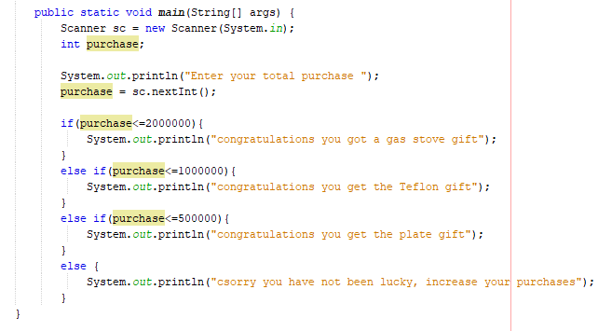
Example

Slide 8
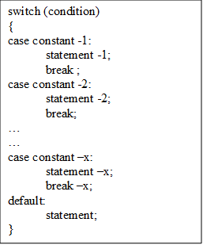
Selection SWITCH-CASE
General Form:
This selection syntax will run one of several "case" statements in accordance with the condition values that are in the "switch". Then the process will continue until the statement "break" is found. However, if there is no value in the case that matches the condition value, then the process will proceed to the statement that is in "default".

Slide 9
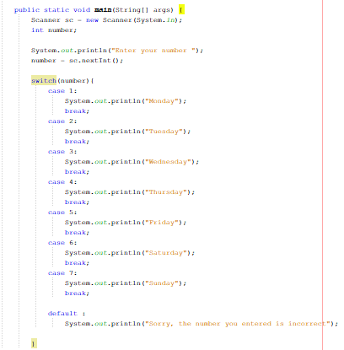
Example

Slide 10
Ternary Operator
Used in the selection syntax
General Form:
syntax(Condition) ? (true condition) : (false condition)

Slide 11
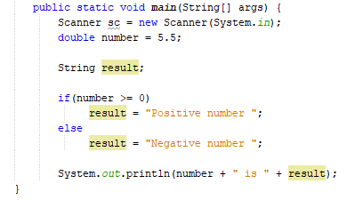
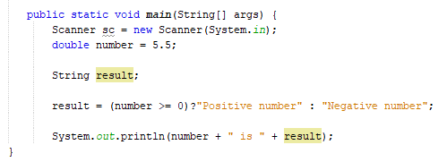
Example

Slide 12
Nested Selection
General Form:
The first condition to be selected is the IF condition which is in the outermost position (condition 1).
If condition 1 is false, then the outermost ELSE statement (pair of the relevant IF) will be processed. However, if the ELSE statement (pair of IF) is not written, then the condition selection will be stopped.
If it turns out that condition 1 is true, then the next condition that is deeper (condition 2) will be selected. If condition 2 is false, then the ELSE statement (pair of the relevant IF) will be processed. However, if the ELSE statement (pair of IF) is not written, then the condition selection will be stopped.
if (condition 1){
if (condition 2){
statement 1;
…
…
if (condition n){ statement 2;
} else {
statement 3;
}
} else {
statement n;
}
} else {
statement x;
}

Slide 13
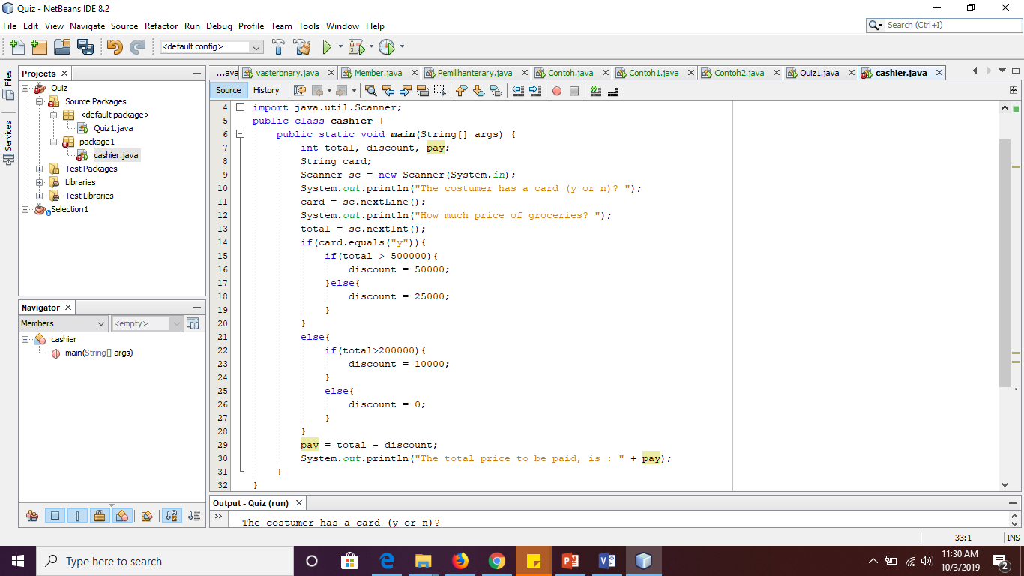
Program Example

Slide 14
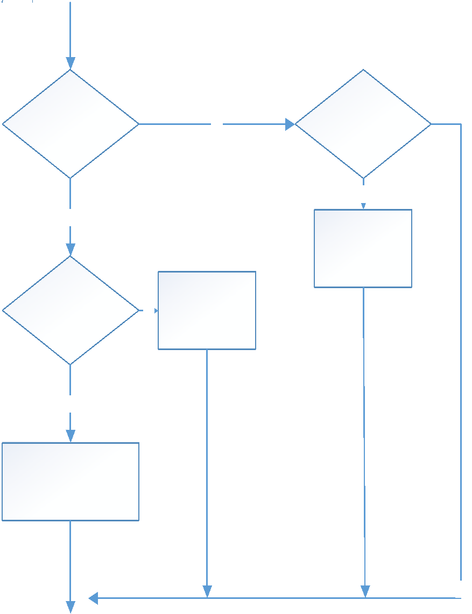
Flowchart Example

Slide 15
LOOPING

Slide 16
Command : for
Syntax for command “for()”:
for(value inisializasion; Terms of recurrence; Change in value)
{
… // The commandments that will be repeated
}
Value insializasion is where we will provide the initial value to the variable counter (variables used to calculate the number of loops).
The recurrence requirement is a condition that must be met in order to keep the loop.
Change in value is a change that will be made in each round to ensure that the loop will not last continuously.

Slide 17
Work Flow for
Start
inisializasion
false
condition
End
true
The commandments that will be repeated
looping

Slide 18
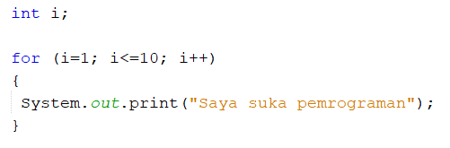
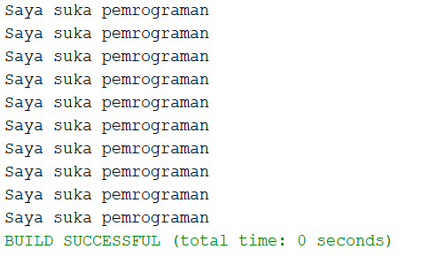
Command : for
Command for() commonly used to loop over the number of known.
Example: I love programming as much as 10 times
Before the loop, the variable I was given a value of 1
The loop will be done during the i < = 10
Output
In each round, the variable I will be added with 1

Slide 19
Command while()
Syntax of the while command ():
while(Terms of recurrence)
{
… // The commandments that will be repeated
}
The recurrence requirement is a condition that must be met in order to keep the loop
While loops will continue to run as long as the recurrence requirement is TRUE

Slide 20
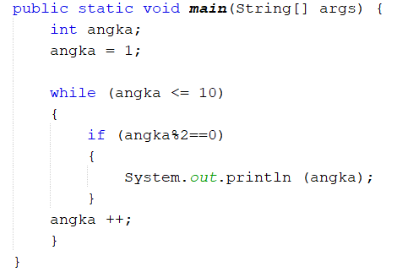
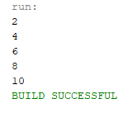
Example command while()
Create a program to print even numbers from 1 to 10
Start
int number
number = 1
number <= 10
F
T
number %2 == 0
T
print(number)
F
End
number ++

Slide 21
Command do-while()
Syntax do-while():
do
{
… // perintah-perintah yang akan diulang
}
while(syarat pengulangan);
In principle, the Do-while () command is the same as the while () command.
The Do-while () command repeats its statement as long as it is fulfilled
.Only, the Do-while () command performs its statementfirst, after which it checks the conditions.
While the while () command checks the terms first.
Therefore, the Do-while () command performs the Statementnya one time, even though the recurrence requirement is not met.

Slide 22
example
class ContohDoWhile {
public static void main (String [] args) {
int i = 6;
do {
System.out.println(“Java”);
i++;
} while (i<5);
}
}

Slide 23
Nested Loop For
for (int i = 0; i < n; i++) {
for (int j = 0; j < n; j++) {
for (int k = 0; k < n; i++) {
// statement
}
}
for (int l = 0; l < n; l++) {
// statement
}
}

Slide 24
Nested Loop While
int i = 0; // index I declaration
// outer loop condition boundary
while (i < n) {
int j = 0; // index j declaration
// innerloop condition boundary
while (j < n) {
// statement
j++
}
i++;
}

Slide 25
Nested Loop Do-While
int i = 0; // index i declaration
do {
int j = 0; // index j declaration
do {
// statement
j++;
} while (j < n);
i++;
} while (i < n);

Slide 26
ARRAY

Slide 27
One-Dimensional Array
Declaration
type namaArrray[];
Atau
type[] namaArrray;
Example: int a[]; int[] a
Type is the data type of the array to be created.
namaArray is the name of the array to be created.

Slide 28
One-Dimensional Array
The Declaration and instantiation of the array object can be combined in an instruction as follows:
type[] namaArrray = new type[element_number];
atau
type namaArrray[] = new type[element_number];
Example :
int[] a = new int[10];
or
int a[] = new int[10];

Slide 29
Access Array Elements
How to access elements from an array variable is done by referring to index number.
nameArray[index]
Example:
It is desirable to access an array variable named with index i, then it can be written: a[i]
Index i can only be 0 or positive with the maximum value is: (element_number-1).

Slide 30
Access Array Elements
Example :
String[] cars = {“Avanza", "Brio", “Inova”};
System.out.println(cars[0]); //Displays Avanza
System.out.println(cars[2]); // Displays Inova

Slide 31
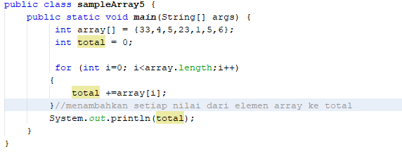

Example
Summation of ARRAYS

Slide 32
2 Dimensional Array (2)
A 2-dimensional array is an array of index numbers using 2 numbers, one for rows and one for columns
Example
Rating
Movie(column)
 | 0 | 1 | 2 | 3
0 | 4 | 3 | 4 | 4
1 | 1 | 1 | 2 | 3
2 | 1 | 2 | 3 | 4
Row
Column
Reviewer
(row)
rating[0][2]=4
rating[1][3]=3

Slide 33
Declaring 2D Array (1)
To declare a 2D array variable, the same as a 1D array. Only different from the number of square brackets "[]"
General form :
data_type[][] array_name = new data_type[x][y];
x = number of rows
Y = number of columns
Example
int[][] arr = new int[10][20];

Slide 34
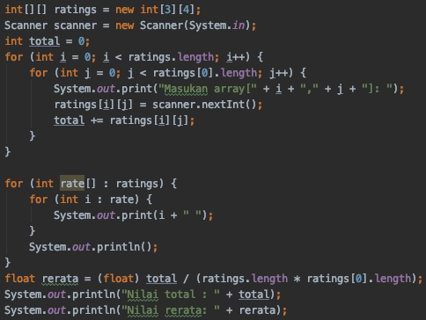
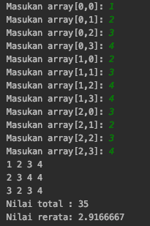
Calculates the average of 2D Array
The average value is obtained from the sum of all matrix element values divided by the product of the size of the row and column arrays

Slide 35
FUNCTIONS

Slide 36
DECLARATION OF FUNCTIONS
static ReturnDataType functionName() {
// statement
// statement
}
Information:
Static : Types functions created are static, in order to directly call in the main function which also are static
ReturnDataType: Data type from the returned value (output) After the function is executed
functionName (): function name be made

Slide 37
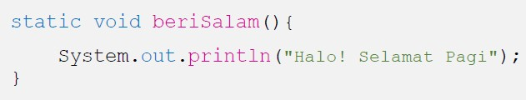
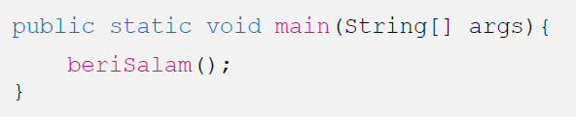
example:
Function Establishment:
Dialing Function:

Slide 38
Function that returns the value ... (1)
A function that can return an output value so that it can be processed in the next process.
Return the value of the function using keyword
return,
Functions that have data type functions other than voids that require a return. The void function does not require a return.
The value returned from a function must match the function's data type. For example if the data type is an int function, then the returned value must be that value.

Slide 39
SCOPE OF VARIABLE ... (1)
Local Variables: variabel declared in a function, and can only be accessed or identified from within the function itself.
Global variables: variables declared outside the block function, and can be accessed or identified from any function.
Global variables in java in the given prefix static
so that these variables can be called directly.

Slide 40
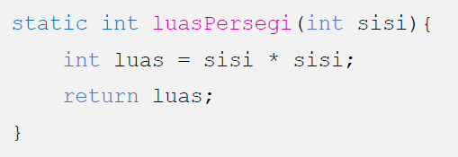
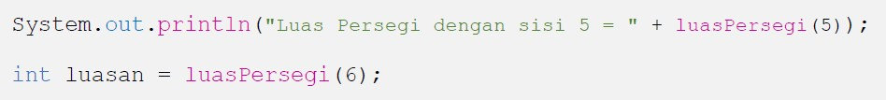
Function that returns a value... (2)
Example
Making the function with parameters and return value:
Dialing functions and give the parameter value:

Slide 41
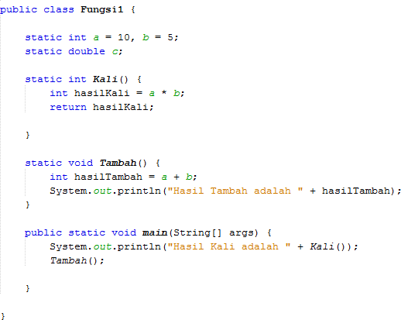
SCOPE OF VARIABLE ... (2)
Global variables
Local variables
Local variables

Slide 42
Recursive Function
Usually a function will be called (CALL) by another function
In a recursive function, in a function there is a command to call the function itself (itself). Thus, the process of calling a function will occur repeatedly
General Form:
Return_value_data_type function_name (data_type parameter_name){
...
Function_name(...)
...
}

Slide 43
Recursive Function Format
In general, the recursive function format has the following form
IF branch is base case, while ELSE is recursion call
The recursion call section provides repetition needed to simplify the problem and the base case provides termination
In order to stop recursion, recursion call should approach the base case in any recursive function calls
if (nilai batas)
//menyelesaikan masalah
else
//mendefinisikan kembali masalah menggunakan rekursi

Slide 44
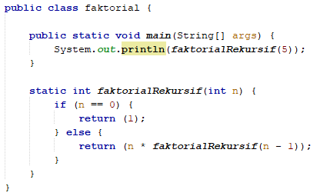
Example1
Factorial function
Base case: n = 0
Recursion call: f(n) = n * f(n-1)
Base case
Recursion call

Slide 45
Example 1 - Trace
n * faktorialRekursif(n-1)
faktorialRekursif(5) = 5 * faktorialRekursif(4)
= 5 * (4 * faktorialRekursif(3))
= 5 * (4 * (3 * faktorialRekursif(2)))
= 5 * (4 * (3 * (2 * faktorialRekursif(1))))
= 5 * (4 * (3 * (2 * (1 * faktorialRekursif(0)))))
= 5 * (4 * (3 * (2 * (1 * 1))))
= 5 * (4 * (3 * (2 * 1)))
= 5 * (4 * (3 * 2))
= 5 * (4 * 6)
= 5 * 24
= 120
Expansion phase
Substitution phase

Slide 46
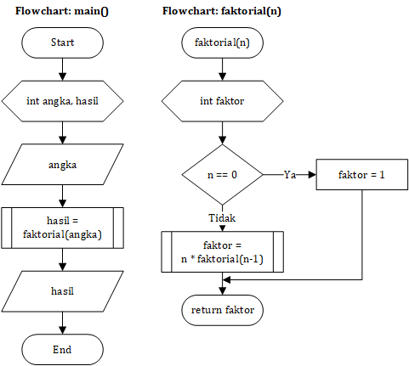
Example 1 - Factorial

Slide 47
PRACTICE
Please create a flowchart/ pseudocode how to solve the case:
Displays a series of numbers from numbers 1 to 15 except numbers 6 and 10, odd numbers are printed with an asterisk "*", even numbers are printed according to the original number.
Example: *2*4* *8* *12*14*
Film
(column)
The problem below uses the function concept:
Calculate the average rating for each film
Look for films that have the highest and lowest average ratings
 | 0 | 1 | 2 | 3
0 | 4 | 3 | 4 | 2
1 | 1 | 2 | 1 | 3
3 | 4 | 3 | 3 | 2
Moviegoers
(row)

